Slide 1


Gabriella, Dávilla and Ithallo
Brazil
Sharing My Compassion Experience
Photography by Sara Navarro

Slide 2
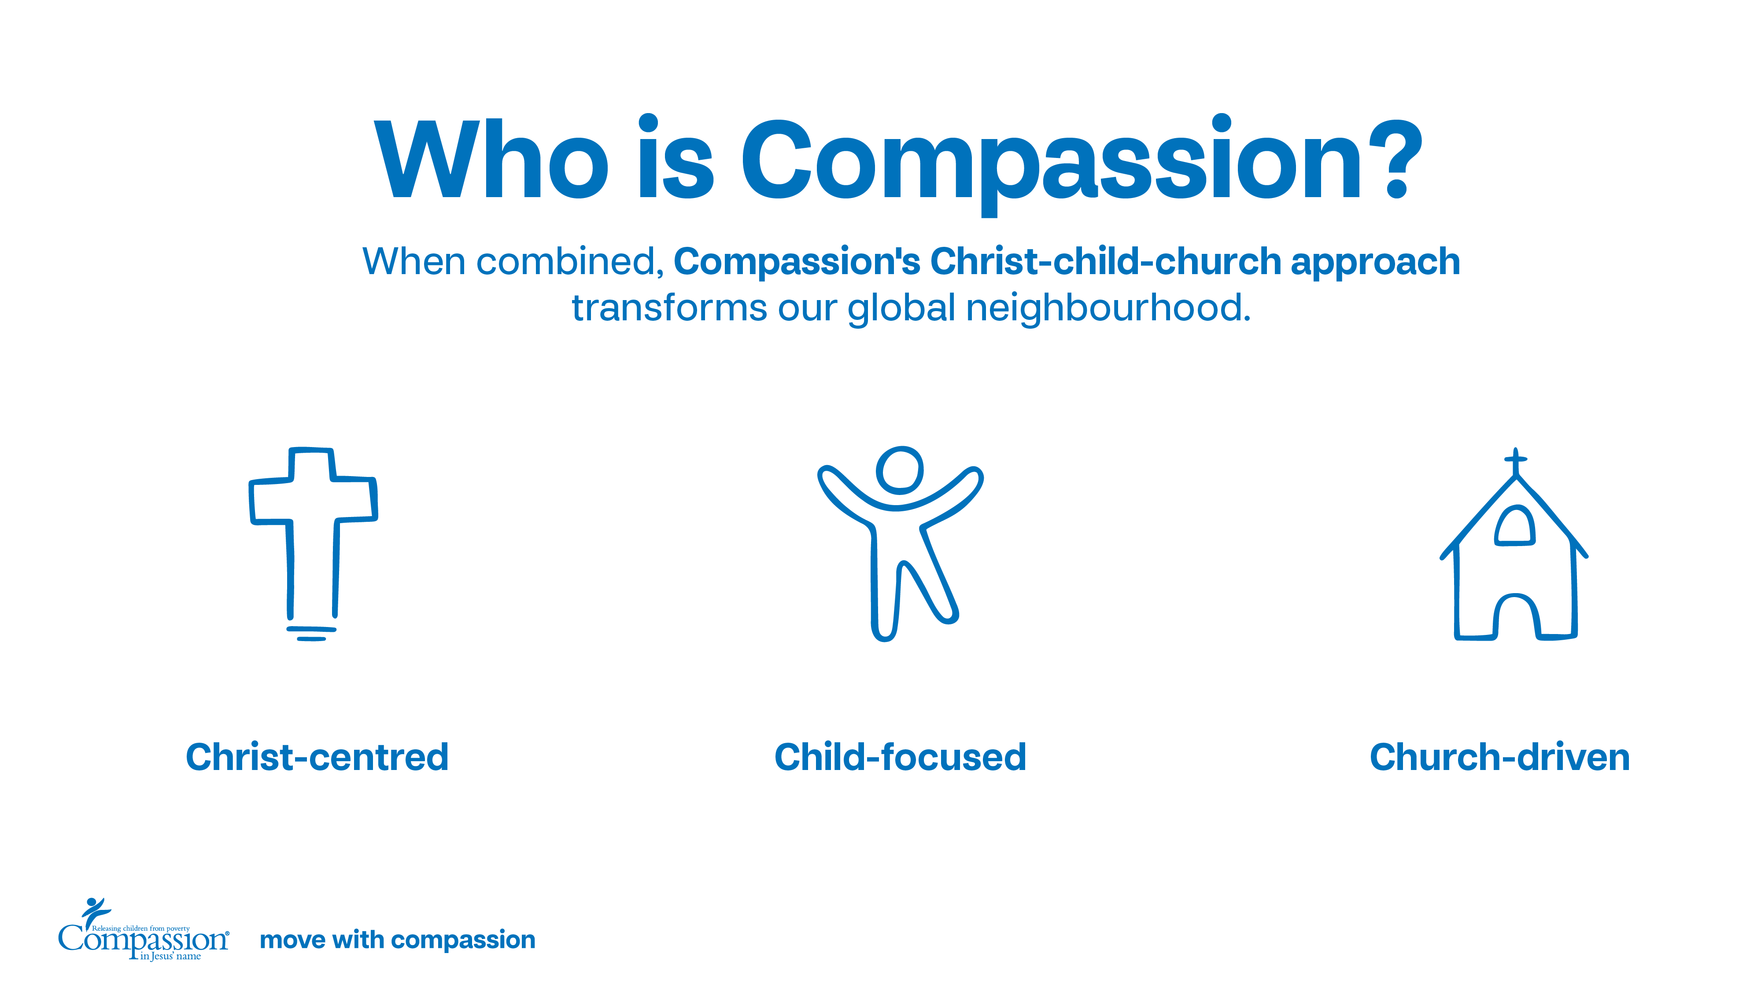
Notes:
Christ-centred: We believe in the power of the transformative love of Christ to change lives. We aim to serve our neighbours around the world the way Jesus did: meeting practical needs and sharing the tangible hope of the good news.
Child-focused: We strategically choose to focus on children, because we believe that an investment in the life of a child also impacts their family, community and nation. We provide kids and youth with the resources and relationships to overcome poverty.
Church-driven: We believe that local churches are uniquely positioned to meet the needs of their neighbours. That’s why we partner with local churches around the world, equipping them to lead and implement programs that spark life transformation in their communities.

Slide 3


Slide 6
Notes:
USE AS NEEDED – if you had a visit or a trip, please delete this slide and use the corresponding one.

Slide 8
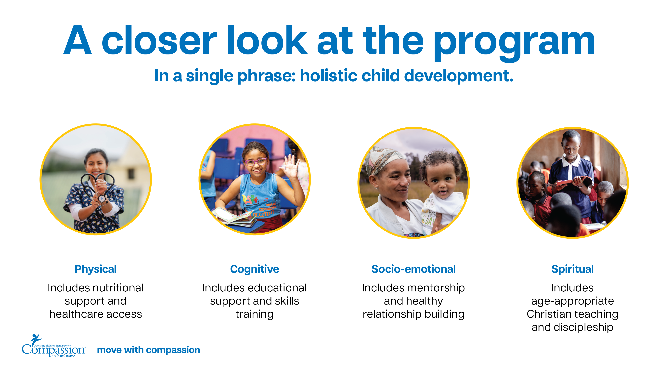
Notes:
Physical development cares for a child’s body through things like nutritional support and access to healthcare. This can look like providing meals, access to safe water or mosquito nets to protect from disease-carrying pests.
Cognitive development cares for a child’s mind through things like education and skills training. This gives children and youth the tools to pursue their dreams and reach academic/career goals.
Socio-emotional development cares for a child’s heart through things like mentorship and opportunities to build healthy relationships. This teaches children and youth resilience and provides them with a support network.
Spiritual development cares for a child’s soul through things like prayer and age-appropriate Christian teaching and discipleship. This lets children know that they are seen and loved not only by their community but by God.

Slide 9
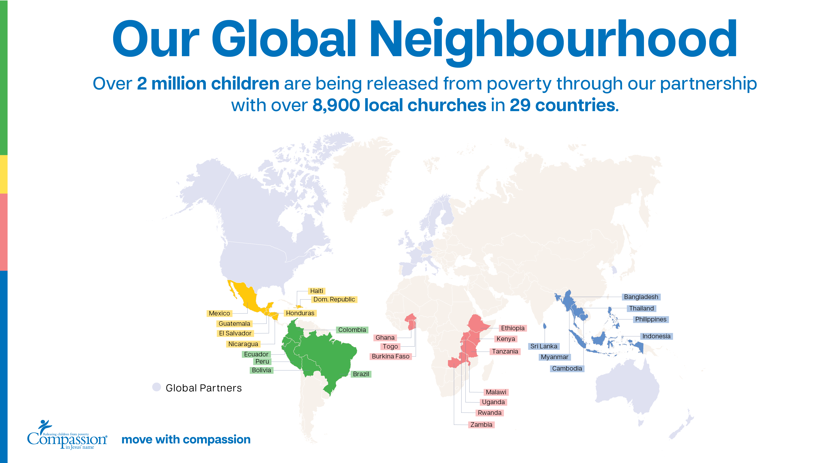

Slide 10
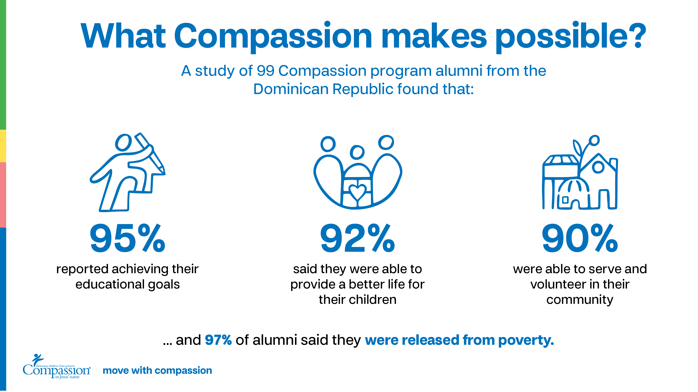

Slide 11
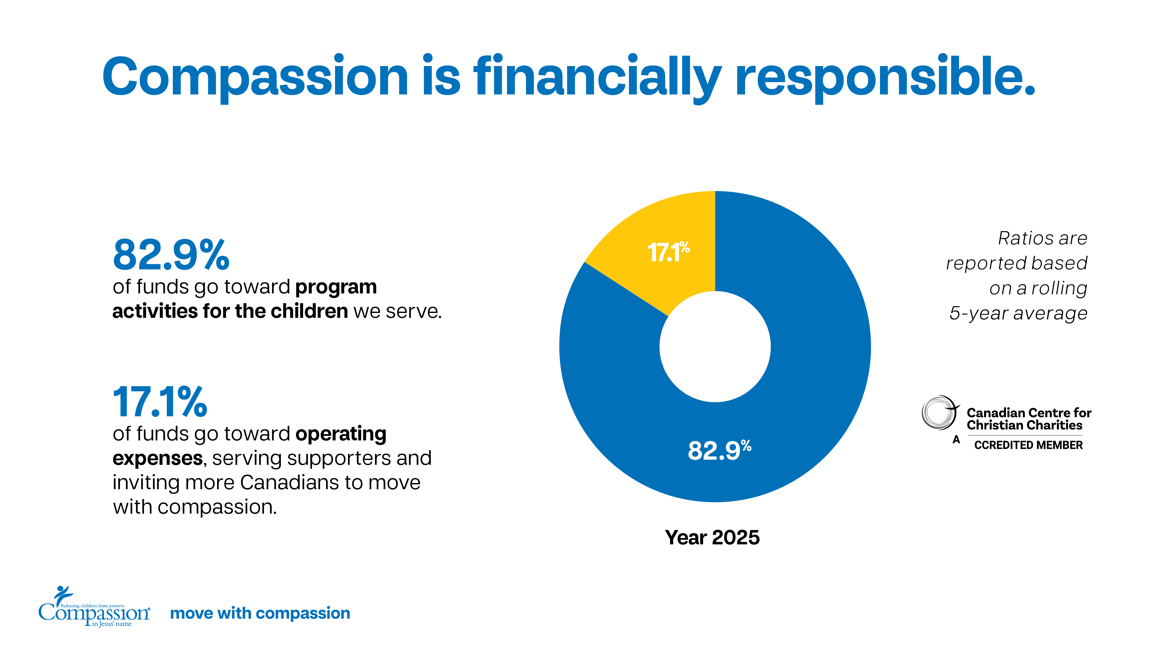

Slide 12
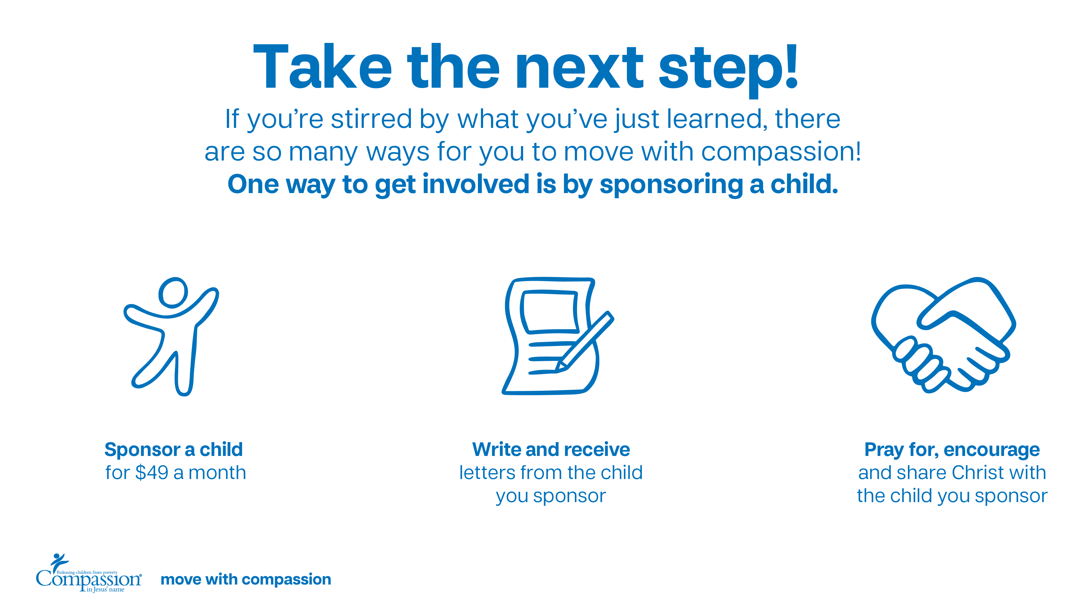

Slide 13
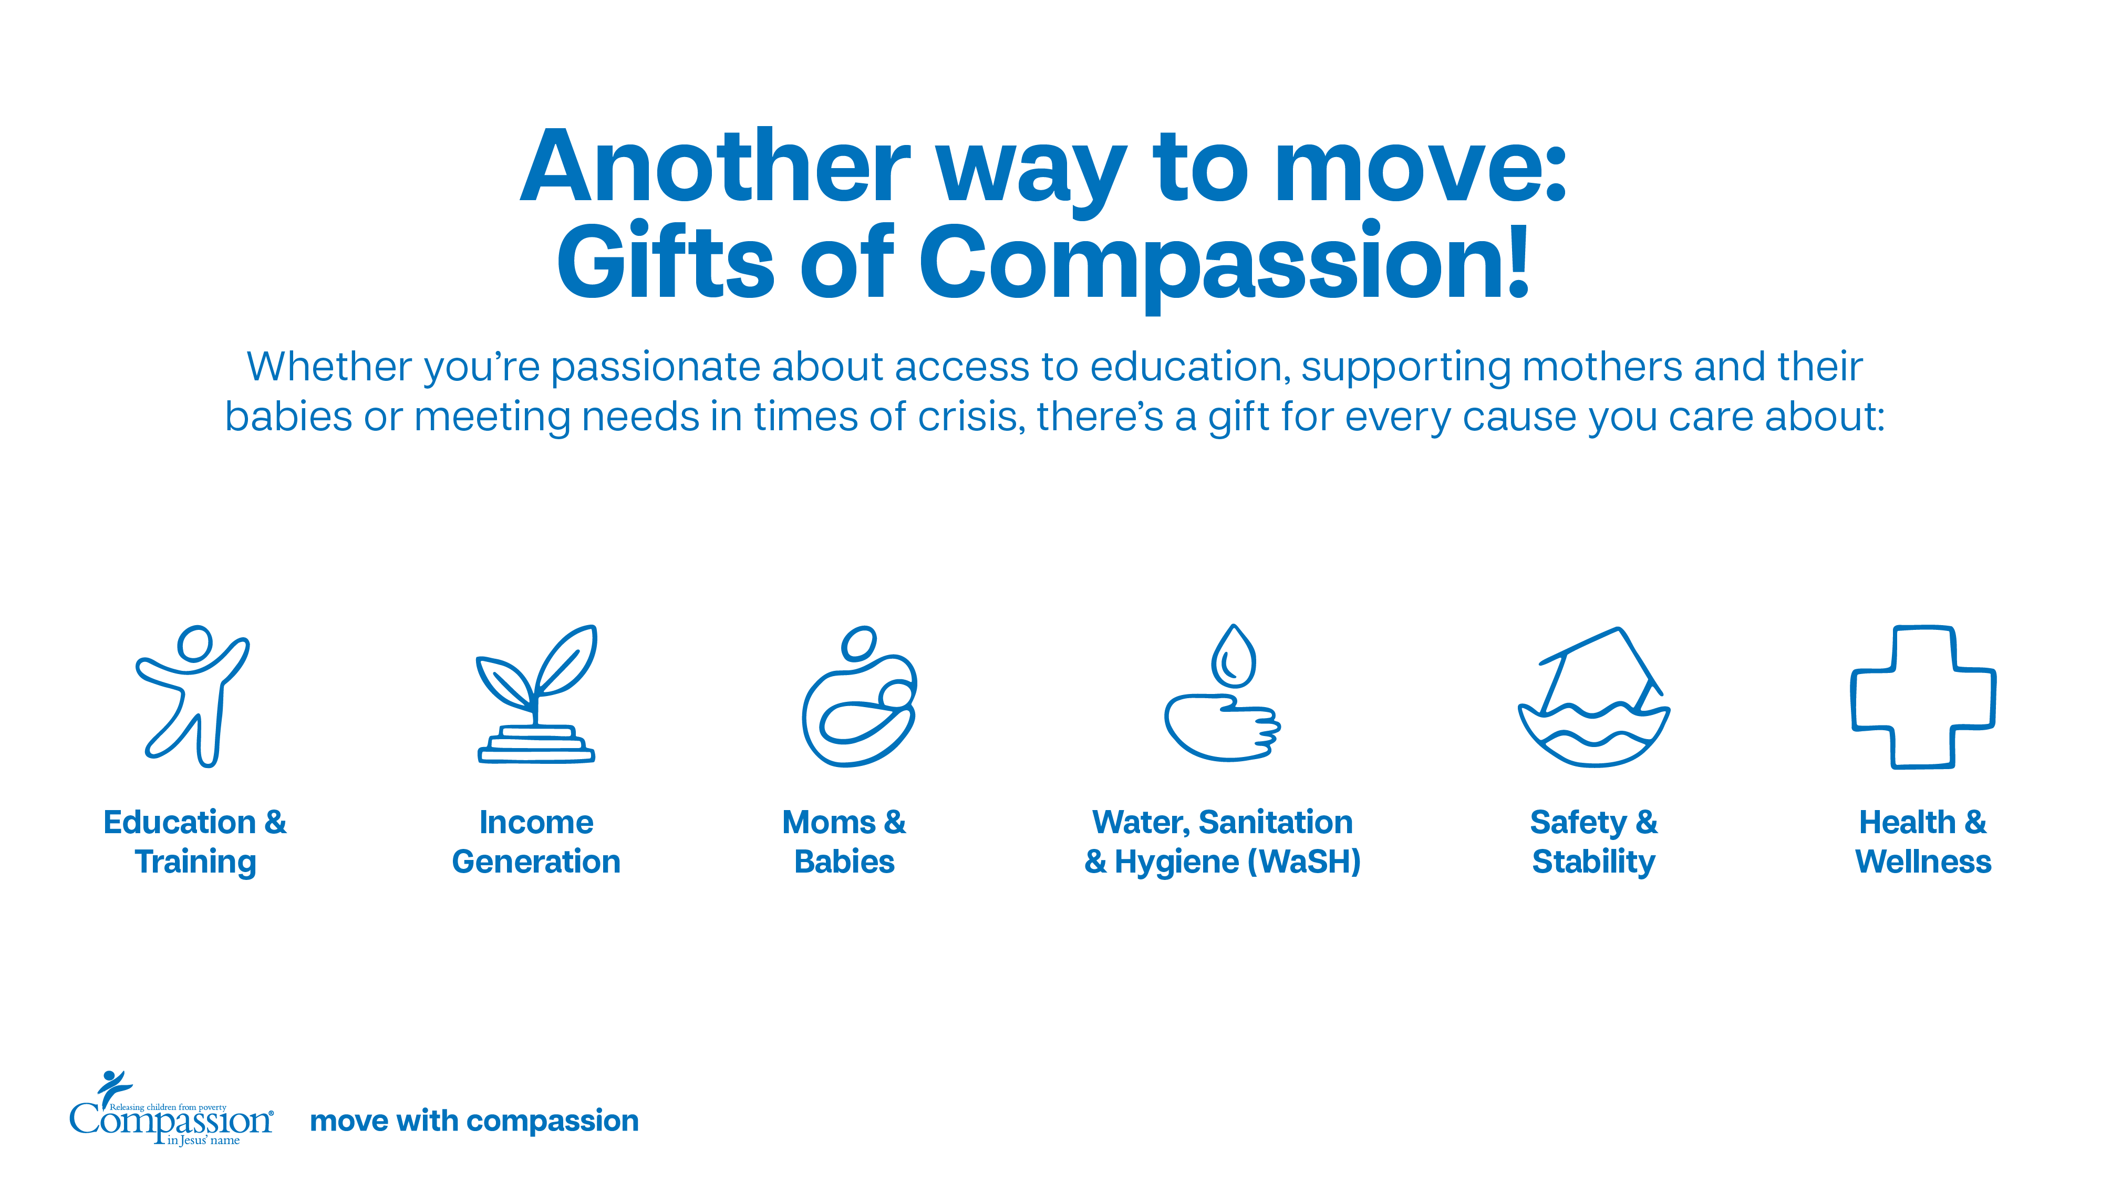
Notes:
Visit compassion.ca for more information about sponsorship.

Slide 14


Notes:
Visit compassion.ca/shop for more information about GOC.

